Slide 1
alimentary, biliary and Dental NURSING
KMTC

Slide 2
Pre-requisite: pharmacology, specialized procedures, Anatomy/Physiology
Broad Objective
This course is designed to enable the learners to promote health, prevent illness, manage and rehabilitate patients suffering from alimentary, biliary and dental disorders

Slide 3
Specific objectives
By the end of this module, the learner should:
Manage patients with oral and dental disorders using the nursing process
Manage patients with alimentary disorders using the nursing process
Manage patients with pancreatic disorders using the nursing process

Slide 4
TERMS IN GIT
Constipation-fewer than three bowel movements a week, or hard, dry and small bowel movements that are painful and, or difficult to pass.
Obstruction-blockage within the G.I.T
Mal-absorption-inability of the small intestines to absorb certain essential substances

Slide 5
Odonophagia-pain on swallowing
Pyrosis-heartburn
Xerostomia –dry mouth
Stomatitis –inflammation of the oral cavity and lips mucosa
Dysphagia –difficulty in swallowing
Achlorhydria –lack of HCL in digestive secretions of the stomach
Stenosis –narrowing or tightening of an opening or passage in the body

Slide 6
COMMON TESTS
Liver enzyme tests
Stool tests
Gastric juice analysis
Endoscopies
Radiographics
CT scan
MRI
X-rays

Slide 7
DISORDERS OF THE ORAL CAVITY

Slide 8

HALITOSIS

Slide 9
It is also known as bad breath or fetor oris. Halitosis can cause significant worry, embarrassment, and anxiety .
estimated to affect 1 in 4 people globally.
If particles of food are left in the mouth, their breakdown by bacteria produces sulfur compounds.
Keeping the mouth hydrated can reduce mouth odor. How to keep mouth hydrated?
The best treatment for bad breath is regular brushing

Slide 10
Causes
Tobacco: Tobacco products cause their own types of mouth odor. Additionally, they increase the chances of gum disease which can also cause bad breath.
Food: The breakdown of food particles stuck in the teeth can cause odors. Some foods such as onions and garlic can also cause bad breath. After they are digested, their breakdown products are carried in the blood to the lungs where they can affect the breath.

Slide 11
Dry mouth: Saliva naturally cleans the mouth. If the mouth is naturally dry or dry due to a specific disease, such as xerostomia, odors can build up.
Dental hygiene: particles of food build up and slowly break down, producing an odor. A film of bacteria (plaque) builds up if brushing is not regular. This plaque can irritate the gums and cause inflammation between the teeth and gums called periodontitis Dentures that are not cleaned regularly or properly can also harbor bacteria that cause halitosis.

Slide 12
Crash diets(a very restrictive meal plan that's unsustainable for the long term). Fasting and low-carbohydrate diet. This is due to the breakdown of reserve fats produces called ketones. that smell
Drugs: Examples include nitrates used to treat angina, some chemotherapy chemicals, and some tranquilizers, such as phenothiazines. Individuals who take vitamin supplements in large doses can also be prone to bad breath.

Slide 13
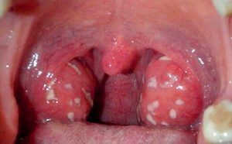
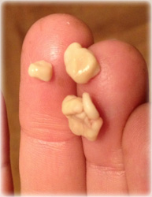
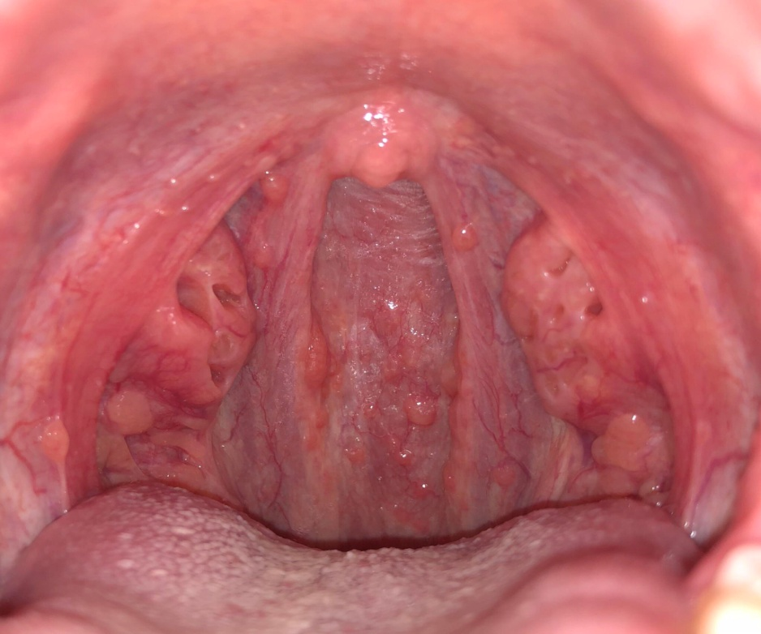
Mouth, nose, and throat conditions: Sometimes, small, bacteria-covered stones can form on the tonsils at the back of the throat and produce odor( tonsilolithiasis). Also, infections or inflammation in the nose, throat, or sinuses can cause halitosis.

Slide 14
Foreign body: Bad breath can be caused if they have a foreign body lodged in their nasal cavity, especially in children.
Diseases: Some cancers, liver failure, and other metabolic diseases can cause halitosis, due to the specific mixes of chemicals that they produce. Gastroesophageal reflux disease (GERD) can cause bad breath due to the regular reflux of stomach acids

Slide 15
HOME REMEDY FOR SMALL STONES
Cotton swab or finger. reach it with a finger or a cotton swab and scrape it off. Do this very carefully as it may cause additional infection if done aggressively or if the stone’s larger. Gargle with salt water immediately after you remove a tonsil stone this way. You shouldn’t do this unless the stone is easy to reach and small.
Coughing. Depending on the size of the stone, coughing could to dislodge a stone in some cases.

Slide 16
Apple cider vinegar or any vinegar. Dilute with water and gargle. Vinegar is supposed to be able to break down the stones because of its acidic content.
Garlic. Studies have shown that garlic has antibacterial, antifungal, and antiviral properties. It may combat bacterial growth and infection.

Slide 17
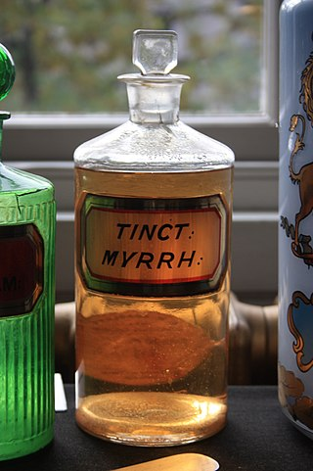
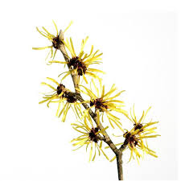
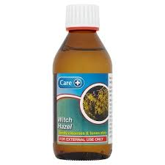
Essential oils. Some oils have anti-inflammatory or antibacterial properties. Examples are myrrh, thieves oil, and lemongrass. These may reduce or eliminate tonsil stones. Dilute the essential oil in a carrier oil and place one or two drops on a toothbrush before brushing the stones. Be sure to follow the directions for each specific oil. Because of the number of bacteria, it’s recommended that you don’t use this toothbrush afterwards

Slide 18
Thieves oil-History-bubonic plague
35 drops clove essential oil.
30 drops lemon essential oil.
15 drops cinnamon bark essential oil.
13 drops eucalyptus essential oil.
7 drops rosemary essential oil.
10 ounces witch hazel or water (optional)

Slide 19
Salt water. One study shows that rinsing with salt water is an effective treatment of oral wounds.
Yogurt. Eating yogurt that contains probiotics may be able to counteract the bacteria causing tonsil stones.

Slide 20
Apples. The acidic content of apples may help combat the bacteria in a tonsil stone.
Carrots. Chewing carrots helps increase saliva and the production of natural antibacterial processes. This may help reduce or eliminate your tonsil stones.
Onions. Onions are believed to contain strong antibacterial properties. Including them in your diet may help prevent or eliminate tonsil stones.

Slide 21
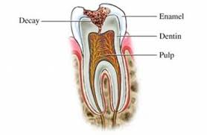
DENTAL CARIES
Local process with demineralization and progressive destruction of dental tissues and formation of cavities
Affect enamel, dentin and pulp
decay
enamel
dentin
pulp

Slide 22
Food residues accumulate and bacterial action produces acid that erodes the enamel. If no action is taken, the enamel is penetrated through into the dentin.
In the dentin, decay progresses more rapidly because the dentin is softer than the enamel and in time reaches the pulp. When the blood, lymph vessels, and nerves are exposed, they become infected and an abscess may form, either within the tooth or at the tip of the root.

Slide 23
Factors enhancing bacterial action
Xerostomia (chronic dryness of the mouth from lack of saliva)
Normally, saliva neutralizes microbially produced acids in the mouth.
It contains bacteriostatic factors

Slide 24
High-carbohydrate diet-more acids while roughage in raw and unrefined foods cleanses the teeth and necessitates more mastication, which further contributes to cleansing of the teeth.
Soft and refined foods tend to stick to the teeth and also require less chewing.
Others:– general state of the organism, – genetic predisposition, – age, –

Slide 25
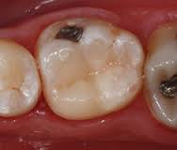
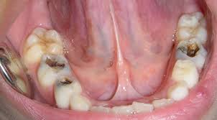
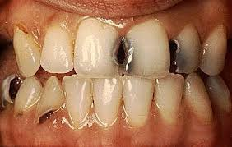

Slide 26
Other causes
Erosion
Mechanical abrasion
Fluoride (excess)
Fluoride(deficient)

Slide 27
Erosion – irreversible loss of tooth structure due to chemical dissolution by acids not of bacterial origin.
Acids of 5.0 -5.7pH from food greatly responsible
Gastric acid(regurgitation)
Work in production of inorganic acids e.g diamond, table salt (professional pathology).

Slide 28
abrasion
loss of tooth structure by mechanical forces from a foreign element.
Possible sources of this wearing of tooth are toothbrushes, toothpicks, floss, and any dental appliance frequently set in and removed from the mouth.

Slide 29
Fluoride: Deficient
Fluoride protects against dental caries by being incorporated into the crystal lattice structure of enamel, where it forms fluorapatite, which is less acid soluble than is the apatite of enamel. Fluoridation of drinking water leads to reductions in dental caries. Normal amount is 0.7-1.2 mg/l.

Slide 30
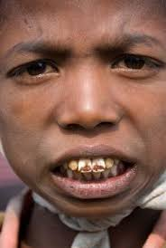
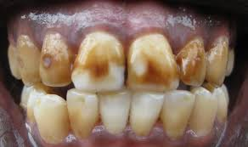
Fluoride: excess (fluorosis)
Dental fluorosis, aka. mottling of tooth enamel, is a developmental disturbance of dental enamel caused by excessive exposure to high concentrations of fluoride during tooth development.

Slide 31
Develops if fluoride concentration in food and water exceeds 2 mg/l
Critical period of exposure is between 1 and 4 years old, no longer at risk after 8 years of age.
Managed by microabrasion and bleaching.

Slide 32
Complications of dental caries
Acute pulpitis: infection in the central cavity of the tooth.
Apical abscess: Bacteria extend from the pulp into the bone surrounding the root of the tooth. Pus may drain into the mouth along the lateral sides of the infected tooth.

Slide 33
Periapical granuloma: granulation tissue that develops inside the healing periapical abscess.
Radicular cyst: If the pus from an abscess is resorbed, a cavity remains. This initial pseudocyst (no epithelial lining) may be partially covered by ingrowths of gingival epithelium.

Slide 34
General Symptoms of dental caries
Toothache
Sensitivity
Holes at the surface of the tooth
Jaw swelling.
Diagnosis
Oral examination-rays

Slide 35
Management
Fillings
Extraction: Complications: Broken tooth, hemorrhage, infection, dry socket, pushing of root into sinus, fractured jaw
Dental implants
Drugs( antibiotics, analgesics)
Fluoridation of water
Good oral hygiene

Slide 36
Dentoalveolar abscess
Dfn-collection of pus in the apical dental periosteum (fibrous membrane supporting the tooth structure) and the tissue surrounding the apex of the tooth.
Clinical manifestations
Dull, gnawing continuous pain
Cellulitis and edema of the surrounding tissues
Mobility of the affected tooth
Fever
Malaise

Slide 37
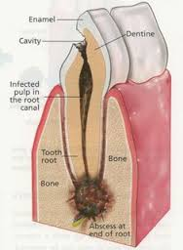
Management
Needle aspiration or drill an opening into the pulp cavity to relieve pressure and pain
Antibiotics
Later extraction or root canal of the affected tooth
Assess for bleeding
Gargle with saline
Giving of the antibiotics
Giving of analgesics
Giving of soft or liquid diet

Slide 38
Cancer of the oral cavity SDL
Staging of cancers
Stage 0:carcinoma in situ( tissue of origin)
Stage I: cancers are localized to one part of the body.( Less than 2cm)
Stage II: cancers are locally advanced(no lymph node involvement)-2cm to 5 cm

Slide 39
Stage III: cancers are also locally advanced( further lymph nodes and structures)-more than 5 cm
Stage IV: cancers have often metastasized, or spread to other organs or throughout the body

Slide 40
Risk factors
Tobacco use of any kind, including cigarettes-has more than 400 carcinogens.
Heavy alcohol use (carcinogen-acetaldehyde )
Excessive sun exposure to lips
A sexually transmitted virus called human papillomavirus (HPV)
Family history
Exposure of radiation

Slide 41
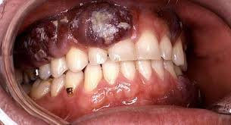
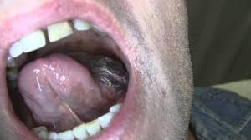
Types of oral cancers
Cancer that affects in the inside portion of the cheeks (buccal mucosa cancer)
Floor of mouth cancer
Gum cancer
Lip cancer
Roof of mouth (hard palate) cancer
Salivary gland cancer
Tongue cancer

Slide 42
Pathophysiology
Risk factor change in normal cell genetic factor abnormal cells forms a clone
Change occurs in surrounding tissues
Infiltration to other areas

Slide 43
Signs and symptoms
A sore that doesn't heal
A lump or thickening of the skin or lining of your mouth
A white or reddish patch on the inside of your mouth
Loose teeth
Poorly fitting dentures
Tongue pain
Jaw pain or stiffness
Difficult or painful chewing
Difficult or painful swallowing
Sore throat
Feeling of a mass in the throat

Slide 44
Diagnosis
Physical exam
Biopsy
Endoscopy
X-rays
CT scan
MRI

Slide 45
Treatment
Surgery to remove the tumor
Reconstructive surgery
Chemotherapy
Radiotherapy
Pain management
Antibiotics
Diet –soft, rich in both calories and proteins
Mouth care

Slide 46
Prevention
Stop tobacco use or don't start
Stop drinking alcohol
Eat a variety of fruits and vegetables –antioxidants
Avoid excessive sun exposure to lips.
See dentist regularly

Slide 47
GINGIVITIS
Dfn-inflammation of the gums.
Predisposing factors
Poor dental hygiene, trauma, infections, vitamin deficiency, hormonal effects, systemic diseases.
Etiology
Fusiform bacilli e.g boreliavincente

Slide 48
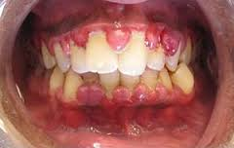
Signs &symptoms
Pain, bleeding, halitosis, fever, metallic taste, enlarged gum
Dx-physical exam
Management
Good oral hygiene
Antiseptic mouth wash
Analgesics
Antibiotics

Slide 49
PERIODONTITIS
Periodontitis gum infection that damages the soft tissue and bone that supports the tooth. It can normally be prevented through good oral hygiene.
It usually manifests as a worsening of gingivitis and then, if untreated, with loosening and loss of teeth.

Slide 50
Pathophysiology
Develops when gingivitis has not been adequately treated. In periodontitis, the deep pockets can harbor anaerobic organisms that do more damage than those usually present in simple gingivitis. The organisms trigger chronic release of inflammatory mediators, including cytokines, prostaglandins, and enzymes from neutrophils and monocytes.

Slide 51
The resulting inflammation affects the periodontal ligament, gingiva, cementum, and alveolar bone. The gingiva progressively loses its attachment to the teeth, bone loss begins, and periodontal pockets deepen. With progressive bone loss, teeth may loosen, and gingiva recedes. Tooth migration is common in later stages, and tooth loss can occur.

Slide 52
Modifiable risk factors that contribute to periodontitis include
Plaque
Smoking
Obesity
Diabetes (especially type 1)
Emotional stress
Vitamin C deficiency(scurvy

Slide 53
Symptoms and Signs
Impaction of food in the pockets can cause pain at meals.
Abundant(hyperplasia) plaque along with redness, swelling, and exudate
Gums may be tender and bleed easily, and breath may be foul.

Slide 54
As teeth loosen, particularly when only one third of the root is in the bone, chewing becomes painful.
Diagnosis
Clinical evaluation
Sometimes dental x-rays

Slide 55
Inspection of the teeth and gingiva combined with probing of the pockets and measurement of their depth are usually sufficient for diagnosis. Pockets deeper than 4 mm indicate periodontitis.
Dental x-rays reveal alveolar bone loss adjacent to the periodontal pockets.

Slide 56
Treatment
Treatment of risk factors
Scaling and root planing
Sometimes oral antibiotics, antibiotic packs, or both
Surgery or extraction
Treatment of modifiable risk factors such as poor oral hygiene, diabetes, and smoking improves outcomes.

Slide 57
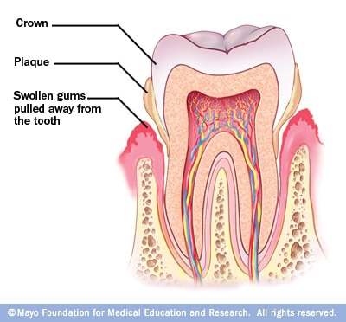

Slide 58
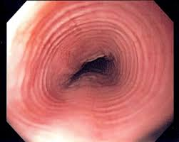
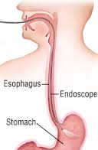
DISORDERS
OF THE
ESOPHAGUS

Slide 59
HIATUS HERNIA
Protrusion of the upper part of the stomach into the esophagus.
Types
type 1: sliding hiatal hernia (~95%). The gastro-esophageal junction (GEJ) is usually displaced >2 cm above the esophageal hiatus

Slide 60
The esophageal hiatus is often abnormally widened to 3-4 cm (the upper limit of normal is 1.5 cm). Small, sliding hiatus hernias commonly reduce in the upright position. The mere presence of a sliding hiatus hernia is of limited clinical significance in most cases.

Slide 61
The function of the lower esophageal sphincter and the presence of pathologic gastro-esophageal reflux are the crucial factors in producing symptoms and causing complications
type 2: paraesophagea/Rolling hiatal hernia with the gastro-esophageal junction in a normal position.
The GEJ remains in its normal location while a portion of the stomach herniates above the diaphragm

Slide 62
type 3: mixed or compound type, paraesophageal hiatal hernia with displaced gastro-esophageal junction
The mixed or compound hiatus hernia is the most common type of paraesophageal hernia.

Slide 63
The GEJ is displaced into the thorax with a large portion of the stomach, which is usually abnormally rotated. Large paraesophageal hernias, with most of the stomach in the thorax, increases the risk for complications such as volvulus, obstruction, and ischemia

Slide 64
The gastroesophageal junction is herniated above the diaphragm and the stomach is herniated alongside the esophagus.
type 4: mixed or compound type hiatal hernia with additional herniation of viscera. (worsening of type III)

Slide 65
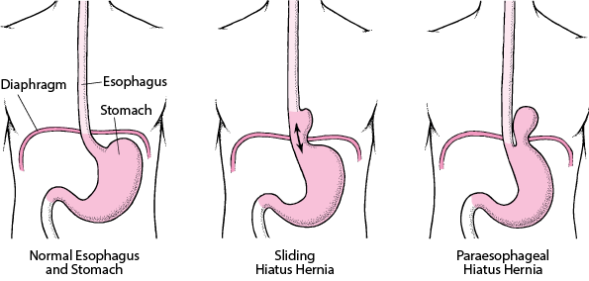

Slide 66
CAUSE
Any condition that will increase abdominal pressure e.g. Strenuous coughing, pregnancy, obesity ,valsava maneuver.
Symptoms
Usually asymptomatic but one can have heartburn
Belching
Sub sternal or epigastric pressure
Pain after eating

Slide 67
diagnosis
Esophagoscopy
Barium meal

Slide 68
Management
Small feeds
Elevate head of bed during bed time
Medication(antacid, histamine receptors, proton pump inhibitors)
Surgical repair

Slide 69
Gastro-oesophangeal reflux Disease
Backflow of gastric or duodenal contents into the esophagus.
Symptoms
Pyrosis, dyspepsia, dysphagia, hypersalivation, flatuelnce, nocturnal cough, wheezing, hoarseness of voice
Diagnosis
Barium swallow, endoscopy

Slide 70
Management
Health education
Diet
Medication(proton pump, histamine antagonists ,Prokinetic agents)
Surgical management
Nissen fundoplication

Slide 71
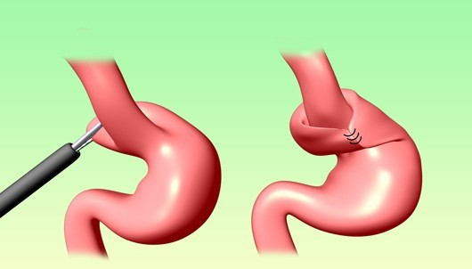
Nissen fundoplication

Slide 72
Cancer of the oesophagus
Occurs 3 times in men than in women
Associated with alcohol and tobacco use
Risk factors
Ingestion of hot foods
Poor oral hygiene

Slide 73
Ca esophagus contd….
Exposure to nitrosamines
Cigarette smoking
Chronic alcohol consumption

Slide 74
Pathophysiology
Starts as a small growth usually in the squamous layer. Tumor spreads rapidly due to lack of serosa layer. Spread is through lymphatic and the systemic circulation. Inner layer invasion causes ulceration, later the whole wall is invaded. There is hypertrophy of the affected cells

Slide 75
S/S
Diagnosis
Biopsy
CT chest
Endoscopic ultrasound
Management
-Surgical
-Pain
Dysphagia
Sensation of a mass in the throat
Sub sternal pain
Regurgitation of undigested food
Hiccups
Foul smell
Dyspnea
Hemorrhage

Slide 76
Post –op care
Complications
Aspiration pneumonia
Esophageal obstructions
Tracheo-esophageal fistulas
Observations
NBM
Intercostal drain management
Pain control
Antibiotics
IV fluids
Removal of stitches on the 10thday
Other nursing care per the patients needs

Slide 77
DISORDERS OF THE STOMACH

Slide 78
GASTRITIS
Inflammation of the stomach mucosal surface
Pathophysiology
Reduced mucus secretion reduced
Surface protection HCL
Destroys the epithelium

Slide 79
Predisposing factors
Nsaids
Excessive alcohol consumption
Food poisoning
Cigarette smoking
Cytotoxic drugs
Ingestion of corrosive poisons, acids and alkalis
Regurgitation of bile into the stomach
Helicobacter associated gastritis
Autoimmune causes

Slide 80
Clinical manifestations
Anorexia
Abdominal discomfort
Epigastric pain
Hemorrhage
Signs of anemia

Slide 81
Management
Restrict the patient from the irritants
-If it is persistence IV fluids
-dilute the alkaline(lemon juice or vinegar) or acids( aluminium hydrochloride).
-Lavage is indicated if the corrosion is extensive
-NG feeding

Slide 82
Drugs (analgesics, antacids and sedatives)
-Surgery( gastric resection or gastrojejunostomy) if there is a gangrene or perforation.
-H.Pylori kit( clarithromycin,amoxyl and esomeprazole)
Assignment-morbid obesity, gastric cancer

Slide 83
PEPTIC ULCER DISEASE
Erosion of the mucosa and sub mucosal lining of the GIT tract.
An “ulcer” is an open sore. The word “peptic” means that the cause of the problem is due to acid.
Most of the time when a gastroenterologist is referring to an “ulcer” the doctor means a peptic ulcer.

Slide 84
Sites
Duodenal ulcers
Gastric ulcers
Esophageal ulcer

Slide 85
Contrary to general belief, more peptic ulcers arise in the duodenum (first part of the small intestine, just after the stomach) than in the stomach.
Duodenal ulcers usually first occur between the ages of 30-50 years and are twice as common in men as in women.
Stomach (or gastric) ulcers usually occur in people older than 60 years and are more common in women.
Ulcers come when the defense mechanisms fail

Slide 86
Stomach defense mechanisms
Pre-epithelial factors:-mucus-bicarbonate-phospholipid barrier, HCL that makes environment unfriendly to most organisms
Epithelial:- layer of simple columnar cells that is hydrophobic and interconnected by tight joints with continuous, and well-coordinated cell renewal which maintains constant structural integrity of the mucosa,

Slide 87
Post-epithelial factors
continuous blood flow that delivers oxygen and nutrients with the simultaneous removal of toxic substances,
an endothelial barrier that produces nitric oxide and prostacyclin to oppose the damaging effects of vasoconstrictors and inflammation in the microcirculation, and

Slide 88
sensory innervation which helps regulate mucosal blood flow and gastric motility.
These critical mechanisms exist under normal conditions to balance out injurious factors and prevent the development of ulcers and their complications.

Slide 89
Etiology
Increased gastric juices/intestinal juices
Erosion and inflammation of the mucosa
Causes
Helicobacter pylorii
Stress
Diet
Cigarette smoking
Alcohol
Nsaid
Pancreatic gastric secreting tumor

Slide 90
Pathophysiology
Peptic ulcers are produced by an imbalance between the gastro-duodenal mucosal defense mechanisms and damaging forces of gastric acid and pepsin, combined with superimposed injury from environmental or immunologic agents.

Slide 91
The mucous membrane lining the digestive tract erodes and causes a gradual breakdown of tissue. This breakdown causes a gnawing or burning pain in the upper middle part of the belly (abdomen).

Slide 92
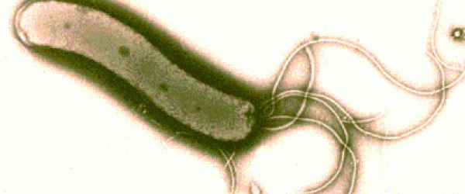
H. pylori
80% of ulcers are associated with Helicobacter pylori, a spiral-shaped bacterium that lives in the acidic stomach. Requires a little oxygen for survival
It is capable of forming biofilms and can convert from spiral to a possibly viable but nonculturable coccoid form, both likely to favor its survival and spread

Slide 93
Infection is usually contracted in childhood, perhaps through food, water, or close contact with an infected individual.
H. pylori associated with a 1-2% lifetime risk of stomach cancer and a less than 1% risk of gastric MALT lymphoma

Slide 94
Usually doesn't cause problems in childhood, if left untreated it can cause ulcers by:
-- infecting and inflaming the stomach and duodenal lining which weakens their defenses.
--Disturbing the mechanism which normally switches off acid and pepsin production after a meal has been digested so that more acid is produced on empty stomach

Slide 95
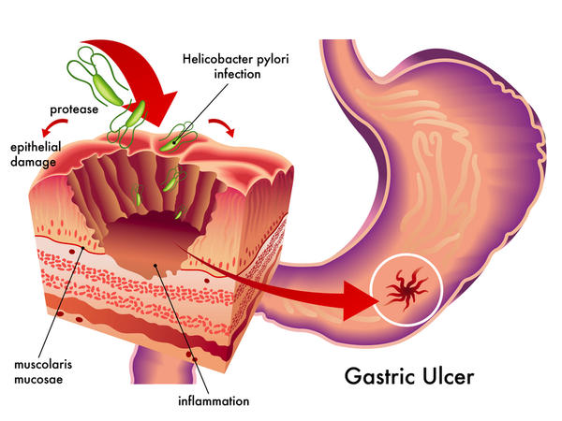

Slide 96
Stress
Stress related mechanisms: increased catecholamine release, vasoconstriction, and secretion of pro-inflammatory cytokines .
These effects are initially beneficial because they shift blood away from the GI tract and to critical organs such as the brain . However, when they persist they cause damage by breaking down gastric mucosal defenses, leading to injury and ulceration.

Slide 97
Decreased blood flow results in poor oxygen delivery and ischemic damage which have structural and chemical consequences.
Loss of the epithelial cell layer that separates the contents of the gastric lumen with the body’s interior milieu leads to increased permeability and back-diffusion of protons and pepsin which further damages the mucosa

Slide 98
Hypoperfusion also triggers the production of oxygen radicals and the decreased synthesis of gastro-protective prostaglandins which can lead to an aggressive inflammatory response

Slide 99
Interestingly, reperfusion injury also plays a significant role in the pathogenesis of stress ulcers. Once blood flow is restored to ischemic tissue, the sudden hyperemia brings in an influx of inflammatory cells and cytokines that result in even more cell death.

Slide 100
Both ischemia and reperfusion cause and worsen gastric dysmotility through the effect of cytokines on the enteric nervous system.
Poor motility aggravates the situation because the persistence of acidic material and other irritants increase the risk of ulcer formation and persistence

Slide 101
Therefore in management, we should aim at maintaining gastric motility, improving the hemodynamics, and the overall medical status of your patients to help prevent splanchnic hypoperfusion, as well as providing acid suppression, typically with a proton pump inhibitor

Slide 102
NSAIDS
Topical irritant effect on the epithelium,
Destroys the tight junctions
Suppression of gastric prostaglandin synthesis,
Reduction of gastric mucosal blood flow and interference with the repair of superficial injury.

Slide 103
NSAIDs acids contribute to ulcers pathogenesis and bleeding, by impairing the restitution process, interfering with hemostasis and inactivating several growth factors that are important in mucosal defense and repair.

Slide 104
Smoking
Smoking and chronic nicotine treatment stimulate gastric and HCL acid output which is more pronounced in the smokers having duodenal ulcer.
This increased gastric acid secretion is mediated through the stimulation of H2-receptor by histamine released after mast cell degranulation and due to the increase of the functional parietal cell volume or secretory capacity in smokers.

Slide 105
Nicotine stimulates pepsinogen secretion by increasing chief cell number or with an enhancement of their secretory capacity.

Slide 106
Long-term nicotine treatment in rats also significantly decreases total mucus neck cell population and neck-cell mucus volume.
Smoking also increases bile salt reflux rate and gastric bile salt concentration thereby increasing duodeno-gastric reflux that raises the risk of gastric ulcer in smokers.

Slide 107
Smoking and nicotine not only induce ulceration, but they also potentiate ulceration caused by H. pylori, alcohol, nonsteroidal anti-inflammatory drugs

Slide 108
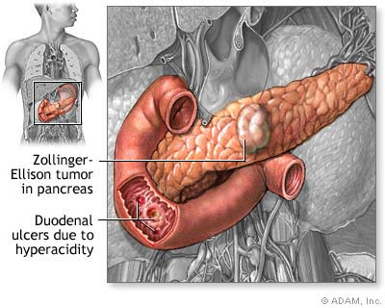
Gastrinomas (Zollinger Ellison syndrome), rare gastrin-secreting tumors, also cause multiple and difficult to heal ulcers.

Slide 109
Diet
Beverages and foods that contain caffeine can stimulate acid secretion in the stomach. This can aggravate an existing ulcer, but the stimulation of stomach acid can't be attributed solely to caffeine.

Slide 110
Peptic Ulcers
Strictly, pepsin exposed ulcers are called peptic ulcers, although the term is applied to mean all esophageal, gastro, duodenal ulcers. Peptic Ulcer is the most common type in the gastrointestinal tract area. Relieved by anti acids.

Slide 111
Found on stomach or duodenum wall.
Pepsin and HCL, when barrier is damaged, digest epithelium.

Slide 112
Duodenal Ulcers
In duodenum.
Duodenum ulcers are usually benign however doctors may take a biopsy to make sure that they are benign.
Usually patients feel a burning sensation and heartburn feelings .Duodenum ulcers will usually begin in the starting point of the small intestine and are this type of Ulcer is much common in western societies than any other. Four less common types are following:

Slide 113
Esophageal Ulcer
Occurs in the lower end of esophagus.
H. pylori common etiology
Patients may feel a lot of pain if acid from stomach refluxes
Causes difficulty and pain in swallowing.

Slide 114
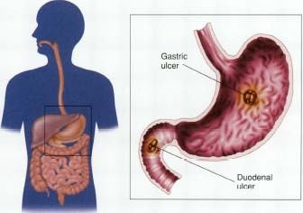
SYMPTOMS

Slide 115
Duodenal ulcers
Age-30 to 50
Male: female= 3:1
Incidence-80%
May have weight gain
Pain 2 - 3 hrs after meals
Gastric ulcers
Usually 60 and over
1:1
15%
May have weight loss
1/2-1 hrs after meals

Slide 116
Duodenal ulcers
Gastric ulcers
Nocturnal awakening
Vomiting uncommon
Hemorrhage less likely
Perforation more likely
No nocturnal awakening
Vomiting common
Hemorrhage more likely
Perforation less likely

Slide 117
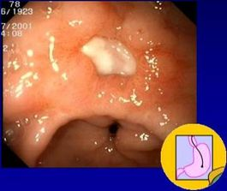
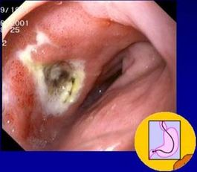
Endoscopy

Slide 118
Predisposing factors
Age 60 or older (stomach lining becomes
more fragile with age).
History of ulcers and internal bleeding
Use of steroids
Blood thinners, such as warfarin.
Alcohol
tobacco

Slide 119
Stress (doesn’t cause ulcers, but a contributing factor)
Chronic disorders: liver disease, emphysema, R. arthritis =stress
Irregular or skipped meals
Type O blood (for duodenal ulcers)

Slide 120
COMPLICATIONS
GI bleeding is the most common complication. It occurs when the ulcer erodes one of the blood vessels.
Perforation Erosion of the gastro-intestinal wall by the ulcer leads to spillage of stomach or intestinal content into the abdominal cavity. The first sign is often sudden intense abdominal pain. Posterior wall perforation leads to pancreatitis; pain in this situation often radiates to the back.

Slide 121
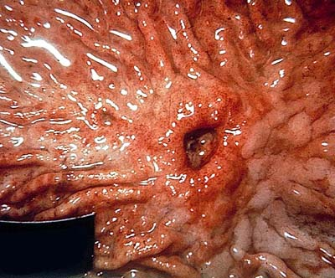

Slide 122
Penetration is when the ulcer continues into adjacent organs such as the liver and pancreas
Scar tissue Scarring and swelling due to ulcers causes narrowing in the duodenum and gastric outlet obstruction. Patient often presents with severe vomiting. Peptic ulcers can also produce scar tissue that can obstruct passage of food through the digestive tract, causing one to become full easily, to vomit and to lose weight.

Slide 123
TREATMENT

Slide 124
GOALS OF TREATMENT
Lowering the amount of acid that stomach makes,
Neutralizing the acid
protecting the injured area so it can heal
It's also very important to stop smoking and drinking alcohol

Slide 125
Prevent complications (bleeding, perforation, penetration, obstruction)
Minimize recurrences
Reduce financial costs

Slide 126
Antibiotic medications. Combinations of antibiotics to treat H. pylori because one antibiotic alone isn't always sufficient to kill the organism.
-amoxicillin (Amoxil), clarithromycin (Biaxin) and metronidazole (Flagyl.

Slide 127
Combination drugs that include two antibiotics together with an acid suppressor or cytoprotective agent (Helidac, Prevpac) have been designed specifically for the treatment of H. pylori infection

Slide 128
Acid blockers. Also called histamine (H-2) blockers — reduce the amount of HCL released into GI. This relieves ulcer pain and encourages healing.
MOA: keeping histamine from reaching histamine receptors.

Slide 129
NB: Histamine is a substance normally present in body. When it reacts with histamine receptors, the receptors signal acid-secreting cells in stomach to release hydrochloric acid. Available by prescription or over-the-counter (OTC), acid blockers include the medications ranitidine (Zantac), famotidine (Pepcid), cimetidine (Tagamet) and nizatidine (Axid).

Slide 130
Antacids. An antacid may be taken in addition to an acid blocker or in place of one. Instead of reducing acid secretion, antacids neutralize existing stomach acid and can provide rapid pain relief.

Slide 131
Proton pump inhibitors. Reduce acid by blocking the action of these tiny pumps. These drugs include the prescription and over-the-counter medications omeprazole (Prilosec), lansoprazole (Prevacid), rabeprazole (Aciphex) and esomeprazole (Nexium). They also inhibit H. pylori.

Slide 132
Cytoprotective agents. Protect the GI mucosa.
sucralfate (Carafate) and misoprostol (Cytotec). bismuth subsalicylate (Pepto-Bismol).

Slide 133
Bowel rest: Bed rest and clear fluids with no food at all for a few days. This gives the ulcer a chance to start healing without being irritated.
Nasogastric tube: Decompression
Urgent endoscopy or surgery if indicated: Damaged, bleeding blood vessels can usually be repaired with an endoscope. The endoscope has a small heating device on the end that is used to cauterize a small wound.

Slide 134
Surgery
Vagotomy
Antrectomy
Pyloroplasty
Tying off an
artery
Other modes
Of treatment
Acupuncture
Chiropracting
Homeopathy
Herbs
Notes:
Chiroprotractor deals with the disorders of the MS and Nervous systems. Manipultes for example spinal joints that have become hypomobile due to injury etc
Using irritants to cure the dsame condition

Slide 135
LIFE STYLE AND HOME REMEDIES

Slide 136
Use of Olive Oil
Don't smoke
Limit or avoid alcohol
Less
Coffee and
Carbonated
Beverages
Avoid nonsteroidal
anti-inflammatory
drugs (NSAIDs)
Exercise
Fruits and
Vegetables
Stress Relief

Slide 137
Read and make notes on pyloric stenosis

Slide 138
DISORDERS OF THE PANCREAS
ACUTE AND CHRONIC PANCRAEATITIS
CANCER

Slide 139
PANCREATITIS Acute
Pancreatitis is the inflammation of the pancreas leading to the obstruction of the pancreatic juices.
Predisposing factors to acute
Gallstones
Alcohol
Viral infections e.g. Mumps
Abdominal trauma

Slide 140
Signs and symptoms
Investigations
Serum amylase
Full hemogram
Urinalysis
Serum calcium(free fatty acids generated by damaged pancreas bind onto serum calcium causing hypocalcemia)
Peritoneal tap
X-ray
Ultra sound
Abdominal pain
Unexplained abdominal mass
Vomiting
Fever
Jaundice
Respiratory distress

Slide 141
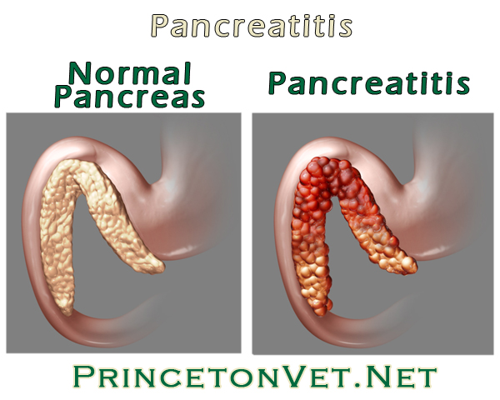

Slide 142
COMPLICATIONS
Chronic pancreatitis
Pseudo cysts
Infected pancreatic necrosis
Systemic inflammatory syndrome; xterised by fever, tachypnea, tachycardia.
Fluid and electrolyte imbalances
Pulmonary atelectasis
Shock and multiple organ dysfunction
Renal failure due to hypovolemia

Slide 143
MANAGEMENT
Patient is on NBM.
Parenteral feeding
Administer a free drainage
Cimetidine is given to reduce HCL
Pain management

Slide 144
Management
Insulin
Fluid/electrolyte balance
Gastric suction
Respiratory care
Pancreatectomy

Slide 145
Chronic pancreatitis
Inflammatory disorder characterized by progressive anatomic and functional destruction of the pancreas.
Risk factors
Chronic alcohol consumption

Slide 146
Symptoms
Investigations
OGTT(oral glucose tolerance test)
CT scan
MRI
X-ray of the abdomen
Endoscopy
Severe abdominal pains
Weight loss
Steatorrhoea

Slide 147
COMPLICATIONS
Diabetes
Jaundice
Pseudocyst
Cancer of the Pancreas

Slide 148
Management
Hypoglycemics and insulin
Pancreatic enzyme replacement
Diet low in proteins
Pancreaticojejunostomy
Health education

Slide 149
CANCER PANCREASE
Ca head of pancreas is the commonest 75%
Risk factors
Cigarette smoking -gender ( male )
Exposure to industrial chemicals
High fat diet
Race ( African/ American
Chronic pancreatitis

Slide 150
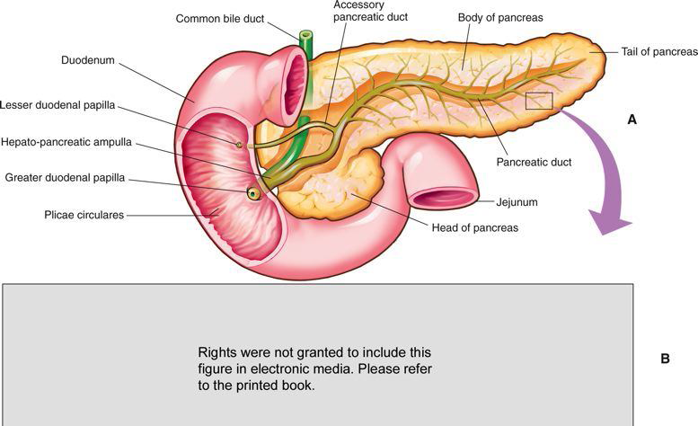
May develop in the head, body or tail of the pancrease.

Slide 151
Symptoms
Investigations
Ultrasound
CT scan
Percutaneous biopsy
Pain –steatorrhoea
Jaundice -nausea and vomiting
Weight loss -pale and gray tools
Signs of diabetes

Slide 152
Monitor for hyper and hypoglycemia
Diet( low proteins, carbohydrates and vitamins)
Pancreatic enzymes
Monitor weight
Fluid balance
Skin care
Inspect suture line
Infection control

Slide 153
DISORDERS OF THE LIVER
Jaundice
Cirrhosis
Cancer
Portal hypertension
Hepatitis

Slide 154
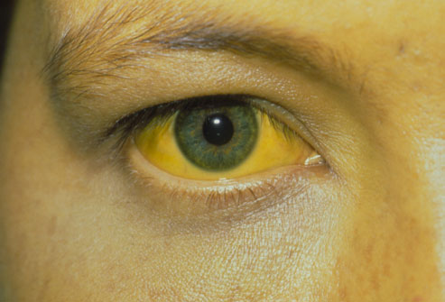
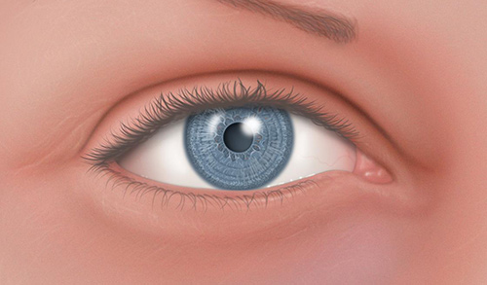
JAUNDICE
Yellowish coloration of the skin, sclera and mucous membrane. Different methods of classification:

Slide 155
Classification of jaundice
According to source in relation to the liver:
Pre hepatic: Hemolysis
Hepatic: Infection in the liver
Post hepatic: Block to bile flow from gall bladder

Slide 156
According to cause
Pathological: Infection e.g malaria
Physiologic: Neonatal RBC hemolysis
Obstructive: Gall bladder stones, any condition preventing the liver from diposing its bile

Slide 157
Conjugation of bilirubin
Breakdown of RBC’S haem>biliverdin> bilirubin
in the Liver it is conjugated with glucoronic acid by enzyme glucuronyltransferase making it soluble in water. Much of it goes to the bile and out into the small intestine. The conjugated bilirubin is not absorbed and passes into the colon and gives the color of the stool

Slide 158
Causes
Breakdown of RBCS
Damage of the liver/muscles
Under absorption of bilirubin by GIT
Investigations
Bilirubin levels
LFTS
Complete blood count

Slide 159
LFTs Normal values

Slide 160
-Abdominal U/S
-Abdominal CT
-Percutaneous transhepatic cholangiogram
-Liver biopsy
-Cholesterol levels

Slide 161
Prothrombin time
Hepatitis A,B,C tests
Endoscopic retrograde cholangiopancreatography

Slide 162
Clinical manifestations
Yellowish coloration of the sclera, skin and mouth
Dark or brown coloured urine
Pale or clay coloured stools
Pruritus
Weight loss
Abdominal pain
Fever
Management
NB according to the cause

Slide 163
HEPATITIS
Inflammation of liver tissue
The most common types are viral. A,B,C
Many cases are asymptomatic and therefore remain undiagnosed.
Pathophysiology
The virus enters the liver cells causing degenerating
Changes. Inflammation process follows
Accompanied by exudates containing lymphocyte, plasma cells and granulocytes.

Slide 164
There is reactive hyperplasia of the macrophages in the sinusoids. Later there is necrosis of the liver cells and tissue. Macrophages try to remove the necrotic materials causing the collapse of the lobules. Blood supply in the lobules is interfered with causing hypoxia and further liver damage.

Slide 165
HEPATITIS A
Caused by RNA virus
Spread through the oral faecal route
Clinical manifestations
Flu like symptoms
Low grade fever
Anorexia
Jaundice
Dark urine
Splenomegally

Slide 166
Management
Complete bed rest
IV fluids
Diet low in protein
Gradual mobilization
Health education
Other nursing care as per the patient needs

Slide 167
Prevention
Administration of hepatitis A vaccine

Slide 168
HEPATITIS B
Caused by DNA virus
Spread through blood, mucous membrane and skin
Also found in semen and vagina
Predisposed people
Health workers
Patients on hemodialysis
Homosexuals
IV drug abusers

Slide 169
Clinical manifestations
Fever
Rashes
Arthralgia
Anorexia
Dyspepsia
General malaise and weakness
Jaundice
Hepatomegally
Splenomegally

Slide 170
Management
Complete bed rest
Diet restricted in protein
Medication( antacids, antiemetics, antispasmodics)
Ambulation
Involve family in care

Slide 171
Patients education
Nutrition
Ways of transmission
Avoid alcohol
Protected sex

Slide 172
Prevention
Control chain of transmission
Early screening
Vaccination
Contact tracing
Treatment of the affected
Health education

Slide 173
HEPATITIS C & D
Hepatitis C
Is associated with blood infusions
Clinical symptom and management are like for hepatitis B
Hepatitis D
Only people with hepatitis B contracts the disease because this virus needs the antigen surface for hepatitis B to attach.
Transmission-sexual intercourse with an infected person
Symptoms and management are like in hepatitis B
Assignment –hepatitis E

Slide 174
Hepatitis C
Affect both the RNA and DNA strands
Target is the liver mostly the b lymphocytes
CAUSES
Sexual intercourse
Sharing needles
Blood and blood products
Mother to child transmission
Signs and symptoms
Usually asymptomatic

Slide 175
PORTAL HYPERTENSION
Its an increase in pressures in the portal system above 5mm/hg.

Slide 176
Review of Portal circulation
The hepatic portal vein drains venous blood from the gastrointestinal tract, spleen, pancreas, and gallbladder to the sinusoids of the liver; from here, the blood is conveyed to the systemic venous system by the hepatic veins that drain directly to the inferior vena cava.

Slide 177
Causes
Liver cirrhosis
Blood clot in the portal vein
Blockage of veins that carry blood from the liver to the heart
Parasitic infections (schistosomiasis)

Slide 178
Causes
Pre hepatic
Intra hepatic
Post hepatic

Slide 179
Pathophysiology
Blockage of vessels high pressures in portal system varices, umbilical hernia. The portal vein drain blood from the stomach intestine, spleen and it is usually under low pressure 5-10mmhg. Any obstruction to blood flow may cause the blood to rise.

Slide 180
Obstruction lead to esophageal, gastric and hemorrhoid varicose veins due to increased venous pressure and there is accumulation of fluid in the abdominal cavity; ascites.

Slide 181
Symptoms
GI bleeding dark stool
Splenomegaly
Ascites
Encephalopathy/confusion
Reduced platelets, reduced WBC cells
Liver biopsy
Abnormal LFTS

Slide 182
Investigations
MRIS
Ultrasound
Doppler ultrasound
Management
Endoscopic therapy
Banding; block bld vessels with a rubber band
Sclerotherapy; a blood clotting solution is injected into the bleeding varices to stop bleeding

Slide 183
Management
Medication
Beta blockers e.g. propranol (Reduces heart rate)
Vasopressin(constricts blood mesenteric blood vessels reducing portal HTN)
Octreotide (reduces GI bleeding pre endoscopy)

Slide 184
LIVER CIRRHOSIS
Damage to the liver tissue and replacement of the normal tissue with scarred tissue. Scar tissue partially blocks the flow of blood through the liver and impairs the liver’s ability to:

Slide 185
control infections
remove bacteria and toxins from the blood
process nutrients, hormones, and drugs
make proteins that regulate blood clotting
produce bile to help absorb fats and fat-soluble vitamins

Slide 186
stages
Stage 1
The first stage of cirrhosis is characterized by the presence of inflammation, characterized by swelling, an influx of inflammatory-promoting immune cells and some destruction of liver tissue. Additionally, there may also be the growth of abnormal connective tissue. These two factors, inflammation and abnormal connective tissue, are confined to the portal area of the liver.

Slide 187
Stage 2
Also characterized by inflammation, but fibrosis is also beginning to occur. Fibrosis is the replacement of normal liver tissue with scar tissue.
No symptoms because the remaining normal liver tissue is able to compensate.
However, scar tissue will not become normal functioning liver tissue, meaning this transformation is permanent.

Slide 188
Stage 3
Damage is more severe.
Fibrosis forms “bridges,” and is called bridging fibrosis. These bridges develop abnormal connections between the hepatic artery, vein and other vessels that cause abnormal blood flow and Hepatic portal hypertension.

Slide 189
Stage 4 (End Stage Liver Disease)
Gross liver malfunction
Many symptoms, including bleeding in the digestive tract, jaundice -- yellow coloring of the eyes and skin, mental effects such as confusion, unusual sleepiness and slurring of speech, build-up of fluid in the body -- edema; and intense and unexplained skin itching.

Slide 190
Types of Cirrhosis(Also etiologic factors)
Alcoholic- involves the production of high levels of metabolites.
Post-necrotic- severe necrosis linked to viral or toxic damage most commonly as a result of hepatitis B or C. Excess iron absorption , high drug dosages are toxic to body
Biliary Cirrhosis- Chronic autoimmune destruction of the inter-hepatic bile ducts by obstructed bile flow. Obstructed bile damages liver tissue.
Trauma, healing with scarring

Slide 191
Pathology
Liver cirrhosis is defined by two principal factors: Portal Hypertension and Hepatic Dysfunction. Portal hypertension is the result of restricted flow of blood through the liver to the hepatic veins and then to the inferior vena cava.

Slide 192
The resulting portal congestion increases portal pressures and decreases blood flow to the liver. With reduced blood flowing to the cirrhotic liver, the hepatocytes have minimal access to blood, severely hampering their capacity to detoxify harmful chemicals.

Slide 193
As a result, toxins become more concentrated in the blood producing damaging effects particularly the production of ammonia (from amino acid breakdown).
Instead of being excreted, ammonia stays in the blood causing hepatic encephalopathy and a noticeable foul breath.
Furthermore, the hepatocytes continue to die leading to a progressive deterioration of the liver’s regulatory capabilities resulting in hypocoagulation and hypoalbuminemia.

Slide 194
Congestion in the hepatic portal system causes blood to be diverted to the collateral vessels forcing them to accommodate larger volumes..

Slide 195
This engorgement causes:
a) the veins to bulge producing easily visible hemorrhoids.
b) dilation of the thin-walled esophagus causing esophageal varices which are subjected to trauma as food is swallowed and can rupture.
With prolonged bleeding time, esophageal varices is a very serious complication of liver cirrhosis

Slide 196
Portal hypertension in liver cirrhosis also causes ascites (accumulation of fluid in the peritoneal cavity) and splenomegaly.
Ascites is caused by hampered albumin production, the osmotic pressure decreases reducing the return of fluid to the blood from the tissues. It results in a significant and pronounced abdominal distention, compressing the abdomen and compromising breathing.

Slide 197
Splenomegaly is the enlargement of the spleen as a result of the inability of the veins that drain the spleen to empty into a congested portal system.
The enlarged spleen increasingly takes up and hold formed elements of the blood causing thrombocytopenia and anemia.

Slide 198
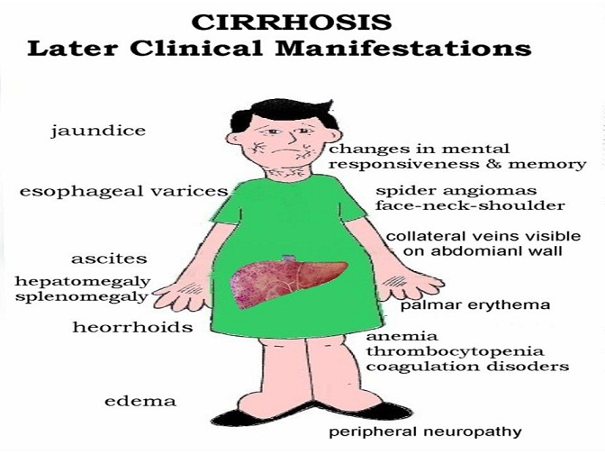

Slide 199
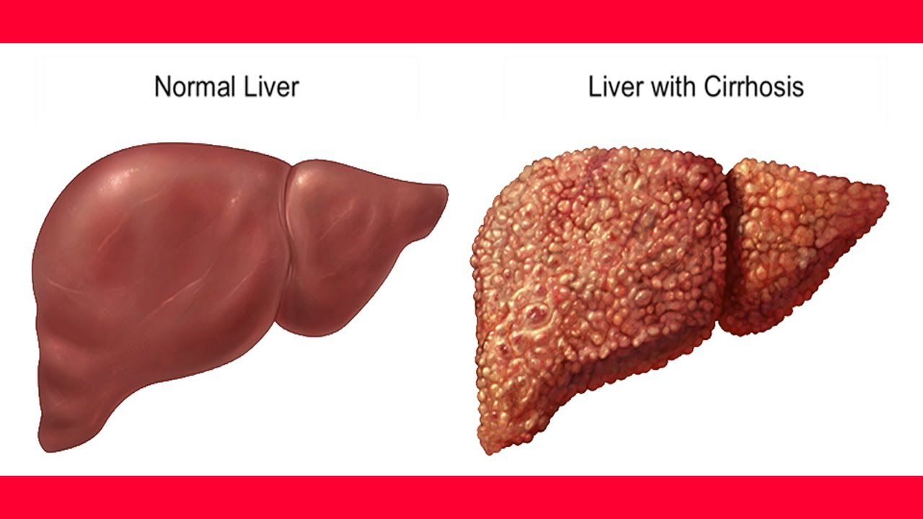

Slide 200
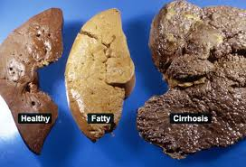

Slide 201
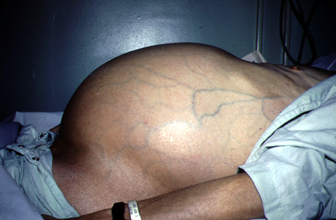
Ascites

Slide 202
S/S
Late
Foul breath
Jaundice
Fatigue
Pain
High Grade Fever
Early
generally feeling unwell and tired all the time
loss of appetite
loss of weight and muscle wasting
nausea and vomiting
tenderness/pain on the RUQ

Slide 203
Early
Late
spider-like small blood capillaries on the skin above waist level (spider angiomas)
blotchy red palms
disturbed sleep pattern
Loss of appetite
Edema
Anemia
Confusion
Bleeding tendencies

Slide 204
Diagnosis
Blood tests
LFTs: should include SGOT (serum glutamic oxaloacetic transaminase ) aspartate transaminase (AST), alanine transaminase (ALT), alkaline phosphatase (ALP), bilirubin, gamma-glutamyltransferase (gamma-GT); AST and ALT are raised due to hepatocyte damage; gamma-GT is high in active alcoholics.

Slide 205
Albumin: there is hypoalbuminaemia in advanced cirrhosis.
FBC: occult bleeding may produce anaemia; hypersplenism may cause thrombocytopenia; macrocytosis can suggest alcohol abuse.

Slide 206
Renal function tests and electrolytes: hyponatraemia may be present (due to increased activity of antidiuretic hormone). Poor renal function may represent hepatorenal syndrome.
Red cell folate: alcohol abuse is often associated with a diet inadequate in folate.

Slide 207
Coagulation screen: abnormalities of coagulation are a sensitive test of liver function; prothrombin time is reduced in advanced cirrhosis.
Ferritin: low ferritin may indicate iron deficiency from diet or blood loss; ferritin is raised in haemochromatosis

Slide 208
Viral antibody screen for hepatitis
U/S
P/E
Chest x-ray will show a raised diaphragm

Slide 209
Management
Nothing can reverses the damaged liver cells state
Treatment aims at preventing the progression and providing symptomatic relief
Class brainstorming

Slide 210
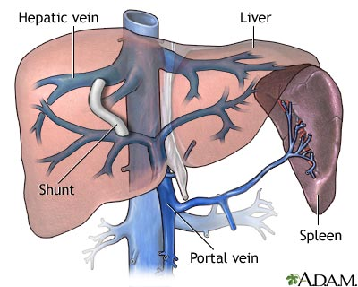
T.I.P.S Transjugular intrahepatic Portosystemic shunt
The goal of TIPS placement is to divert portal blood flow into the hepatic vein, so as to reduce the pressure gradient between portal and systemic circulations

Slide 211
Complications
?????????

Slide 212
CA LIVER
Causes
Hepatitis B virus
Hepatitis C virus
Cirrhosis
Smoking
Chemical agents

Slide 213
Clinical features
Diagnosis
Abdominal u/s
CT scan
Arterial partography
Liver biopsy
LFTS
Anorexia
Nausea and vomiting
Weakness and general malaise
Abdominal mass
Splenomegally
Hepatomegally
Ascites
Jaundice

Slide 214
Management Surgical
Wedge resection
Lobectomyresection
Major liver resection
Total hepatoctomy and liver transplant
Cryotherapy(use of extreme cold to destroy abnormal tissue)
Chemotherapy-Regional, Intra –arterial
Radiation

Slide 215
DISORDERS OF THE GALL BLADDER
Cholelithiasis
Cholecystitis

Slide 216
CHOLECYSTITIS
Inflammation of the gall bladder
Associated with sedentary life style.
Obese persons are more predisposed
Incidences are high at the age of 50’s and 60’s

Slide 217
The Gallbladder
Hollow organ that beneath the liver.
In adults, measures approximately 8 cm (3.1 in) in length and 4 cm (1.6 in) in diameter when fully distended.
Divided into three parts: fundus, body and neck.
The neck tapers and connects to the biliary tree via the cystic duct which then joins the common hepatic duct to become the common bile duct.
At the neck of the gallbladder is a mucosal fold called Hartmann's pouch, where gallstones commonly get stuck.

Slide 218
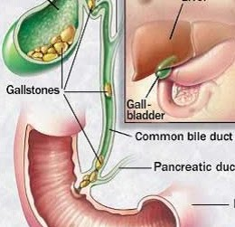

Slide 219
Cholecystitis is the inflammation of the gallbladder, usually resulting from a gallbladder stone blocking the cystic duct.
Lasts for long time and characterized by repeated attacks of pain (biliary colic).
It may become thick walled, scarred and small. The gallbladder usually contains sludge (a microscopic particles or materials similar to gallstones)
These block its opening into the cystic duct or reside in cystic duct itself.

Slide 220
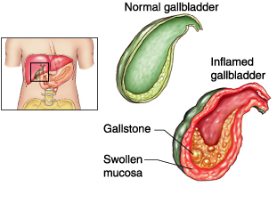

Slide 221
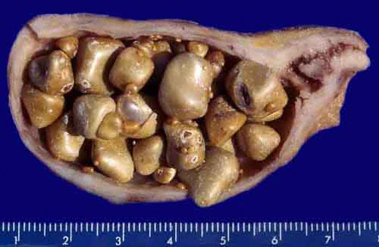
Notice thickness of gall bladder wall, abundant polyhedric stones
and small papillary tumor in the cystic duct.

Slide 222
Pathophysiology
Obstruction of the bile flow, more water absorption causing increased concentration of the bile and irritation of gall bladder
Bacteria and irritants are trapped thus further inflammation

Slide 223
Clinical features
Fever, tachycardia, and tenderness in the RUQ(right upper quadrant) or epigastric region, often with guarding or rebound.
The Murphy sign described as tenderness and an inspiratory pause elicited during palpation of the RUQ.
A palpable gallbladder or fullness of the RUQ .
Jaundice may be noted in approximately 15% of patients.
Patients with chronic cholecystitis frequently have a palpable RUQ mass secondary to fibrosis involving the gallbladder.

Slide 224
Pain : sharp, cramping, steady
Spread to the back or below the right shoulder blade
Other symptoms : clay-colored stools, fever, nausea or vomiting, yellowing of skin(jaundice)

Slide 225
Diagnostic
P/examination.
Ultrasonography is the best way to detect gallstones in the gallbladder or the thickening of its wall.

Slide 226
If possible, the patient should not eat for 6 or more hours before the test, which takes only about 15 minutes. During the procedure, the doctor can check the liver, bile ducts, and pancreas, and quickly scan the gallbladder wall for thickening (characteristic of cholecystitis.

Slide 227
…continue
Liver blood test are often normal unless the person has an obstructed bile duct. Other blood test can detect some complications such as high level of a pancreatic enzyme (lipase or amylase) in pancreatitis.
A high count of WBC suggest inflammation, an abscess, gangrene or a perforated gallbladder.

Slide 228
management
Surgical – removal of the gallbladder (cholecystectomy) is usually done by using a flexible tube called a laparoscope.
This surgery uses a smaller surgical cuts, which results in a faster recovery. Patients are often sent home from the hospital on the same day as surgery or the next morning. Open cholecystectomy requires larger cut in the upper-right part of the abdomen.
Gall stones may also be dissolved with medication taken by mouth. But may take 2 years or longer to work.

Slide 229
Complications
Pain after surgery : a few people have new or recurring episodes of pain that felt on gallbladder even thought the gallbladder and the stones have been removed.
It may be the malfunction of the sphincter of Oddi, the muscle that control the released of bile and pancreatic secretion.

Slide 230
Other possible complication
Cancer of gallbladder (rarely)
Jaundice
Pancreatitis
Worsening of the condition, i.e

Slide 231
Since the pancreas and gall bladder drain into the same duct into the gut, when the pancreas becomes inflamed and swollen, the outflow from the gall bladder gets blocked.
Retention into the gall bladder, is absorbed into the blood.

Slide 232
Management
The condition is not always preventable.
Eating less fatty food may relieve symptoms who have not had their gallbladder removed.

Slide 233
CHOLELITHIASIS
Dfn-collection or presence of stones in the gall bladder
Causes
Altered solubility of the bile content
High levels of blood and dietary cholesterol
Dm
Hemolytic diseases(sickle c, spherocytosis, thalassemia due to high bilirubin levels)
Female gender(estrogen increases biliary cholesterol secretion)
Obesity (increased cholesterol levels)

Slide 234
Clinical manifestations
Intolerance to fatty foods
Nausea and vomiting
Flatulence
Fever
Right upper quadrant discomfort
Right upper quadrant pain
Jaundice
Clay colored stool
Dark colored urine

Slide 235
Diagnosis
A) cholecystitis
-High WBC
-High LFTs

Slide 236
B) cholelithiasis dx
X-ray
Cholecystogram
Cholangiogram
Ultrasonography

Slide 237
Management
Bed rest
Pain control
Antibiotics
Gallstone resolution therapy
Cholecystectomy
Cholecystotomy
Choledochostomy: into common bile duct
Choledocholithotomy: resection of common bile duct

Slide 238
Pre-op care
Restrict food or drinks
Skin preparation
Cleansing enema
Catheterization
Monitor prothrombin time
Administer vitamin k

Slide 239
Post-op care
Management of pain
Semi fowlers position
Splint incision site
Change dressing
Anti embolic stocking
Observe for bleeding
Vital signs
Other nursing care as per the patient’s needs
Health messages

Slide 240
bowel diseases/disorders

Slide 241
INTESTINAL CONDITIONS
Inflammatory (IBD) Crohns, Ulcerative colitis
Obstructions
Diverticular
Other Inflammations
Infections

Slide 242
1. Ulcerative Colitis
Is an ulcero-inflammatory disease affecting the colon, which is limited to the mucosa and submucosa, except in the most severe cases.
It begins in the rectum and extends proximally in a continuous fashion sometimes involving the entire colon (Pancolitis).

Slide 243
Predisposing factors
Any age, but more rampant in between 15 and 30 ^{yrs}
older than 60 ^{yrs}
Positive Family history
Jewish descent-challenged
Causes
Heredity
Overactive immunity
Drugs: Antibiotics, corticosteroids, NSAIDs,
Stress may trigger

Slide 244
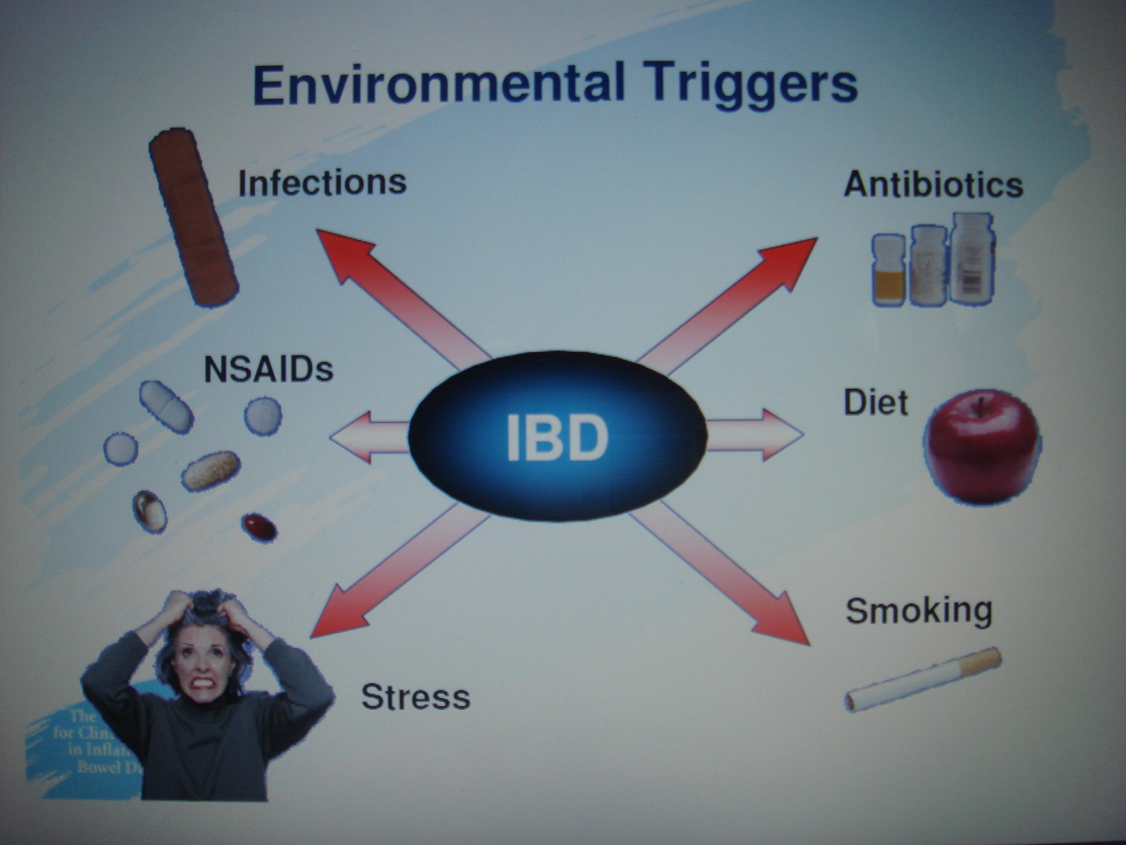

Slide 245
Clinical features
Bloody mucoid diarrhea
Cramps ( a painful & involuntary muscular contraction)
Tenesmus (painful spasm of the anal sphincter along with the urgent desire to defecate without the significant production of feces)
Colicky lower abdominal pain
Fever
Weight loss

Slide 246
Extra-intestinal symptoms
Migratory polyarthritis,
Sacroilitis,
Ankylosing spondilitis,
Uveitis,
Erythema nodosum and
Hepatic involvement (pericholangitis and
Primary sclerosing (cholangitis)-Primary sclerosing cholangitis (PSC) is a long-term progressive disease of the liver and gallbladder characterized by inflammation and scarring of the bile ducts.

Slide 247
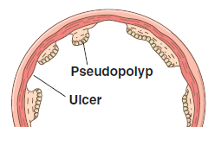

Slide 248
Causes
Abnormal immune response
Genetical
Diagnosis
Colonoscopy

Slide 249
Diagnosis
Medical and family history
Physical exam: distended abdomen, increased bowel sounds, tenderness
Lab tests: Hb (low), occult blood, cell count
Endoscopies of the large intestine

Slide 250
Pathophysiology
The immune system seems to overreact to substances and bacteria in the intestine. White blood cells invade the intestinal lining and produce inflammatory toxins causing chronic tissue swelling, injury and ulceration. The precise cause of this abnormal immune response is unknown.

Slide 251
Management
Aminosalicylates to reduce inflammation
corticosteroids
Immunomodulators to reduce inflammation e.g azathioprine, 6-mercaptopurine, or 6-MP
biologics, also called anti-TNF therapies E.G humira
Colectomy, complete

Slide 252
Complications:
Perforation,
Peritonitis,
Abscess
Toxic megacolon
Venous thrombosis
Carcinoma

Slide 253
Management
Physical and psychological rest
Nutrition ( high calories, minerals, Vitamins, low fats, high fibers)
Fluid and electrolyte balance
Drugs-corticosteroids
Surgery

Slide 254
4. INTESTINAL OBSTRUCTION

Slide 255
Obstruction
A mechanical blockage in small or large bowel arising from a structural abnormality that presents a physical barrier to the progression of gut contents.
Accounts for 5% of all acute surgical admissions
Patients are often extremely ill requiring prompt assessment, resuscitation and intensive monitoring

Slide 256
-Can be partial or complete.
Types/causes
A)mechanical( Dynamic)
B) Non mechanical (Adynamic)

Slide 257
Dynamic | Adynamic
Physical /mechanical obstruction. It may occur in an acute or chronic form. Strong peristalsis in trying to clear the obstruction | Peristalsis Absent
Obstruction lesion may be: Intraluminal (impacted feces, foreign bodies, gallstones) Intramural (malignant or inflammatory strictures) Extramural (intraperitoneal bands and adhesions, hernias, ca ovary, ca stomach, volvulus or intussusceptions.) | l ILEUS, esp. post surgical ¡ INFARCTION ¡ MOTILITY DISEASES, esp., HIRSCHSPRUNG DISEASE

Slide 258
DYNAMIC OBSTRUCTION (MECHANICAL)

Slide 259
Pathophysiology
As mechanical obstruction becomes established, the proximal bowel produces increasingly vigorous contractions in an effort to overcome the obstruction. This accounts for the abdominal colicky pain.
It also begins to dilate, initially due to accumulation of air and increased intestinal secretions. Stagnation of fluid encourages anaerobic bacterial overgrowth leading to fermentation and production of gas, manifesting as dilated bowel loops on plain abdominal radiography

Slide 260
The products of fermentation in the bowel lumen also increase the osmotic gradient causing intraluminal fluid and electrolyte shifts, which compounds the problem leading to abdominal distension. The bowel distal to the obstruction eventually evacuates its contents and collapses, accounting for eventual absence of flatus and feces (absolute constipation). Vomiting may occur as this process evolves. The timing of onset depends on the level of obstruction. The vomitus contains gastric contents initially, then becomes bile stained, and finally feculent.

Slide 261
With increased intraluminal pressure the tension in the bowel wall increases, which subsequently impairs venous drainage of the bowel, leading to capillary congestion and mural edema.
Arterial inflow becomes compromised leading to ischemia.

Slide 262
This results in loss of the bowel's innate immunoprotective mechanism, predisposing to translocation of intraluminal bacteria into the circulation with associated signs of sepsis.
This process is more likely in a 'closed loop obstruction' whereby a closed loop is formed between the proximal and distal segments of the obstructed bowel.

Slide 263
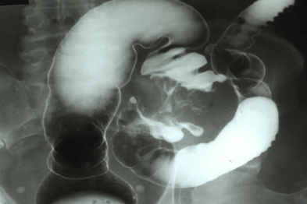

Slide 264
Diagnosis
Physical exam
INSPECTION: Abdominal distention, scars, visible peristalsis.
PALPATION: has abdominal pain, vomiting, increased bowel sounds initially. Mass, tenderness, guarding
PERCUSSION: Tymphanic, dullness
AUSCULTATION: Bowel sound are high pitch and increase in frequency

Slide 265
Lab tests
Complete blood count
Electrolyte levels
Urinalysis
Abdominal x-ray
Barium enema

Slide 266
Obstruction by adhesions
Peritoneal irritation→ local fibrin production→ produces adhesions between apposed surfaces
As early as 4 weeks post laparatomy. The majority of patients present between 1-5 years
Colorectal Surgery 25%
Gynaecological 20%
Appendectomy 14%

Slide 267
Prevention: good surgical technique, washing of the peritoneal cavity with saline to remove clots, etc, minimizing contact w/ gauze, covering anastomosis & raw peritoneal surfaces

Slide 268
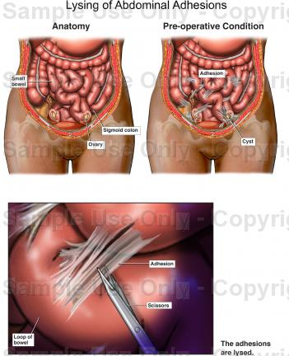
Management
adhesion
Surgery to release

Slide 269
Obstruction by hernias
Hernia is a general term used to describe a bulge or protrusion of an organ through the structure or muscle that usually contains it.

Slide 270
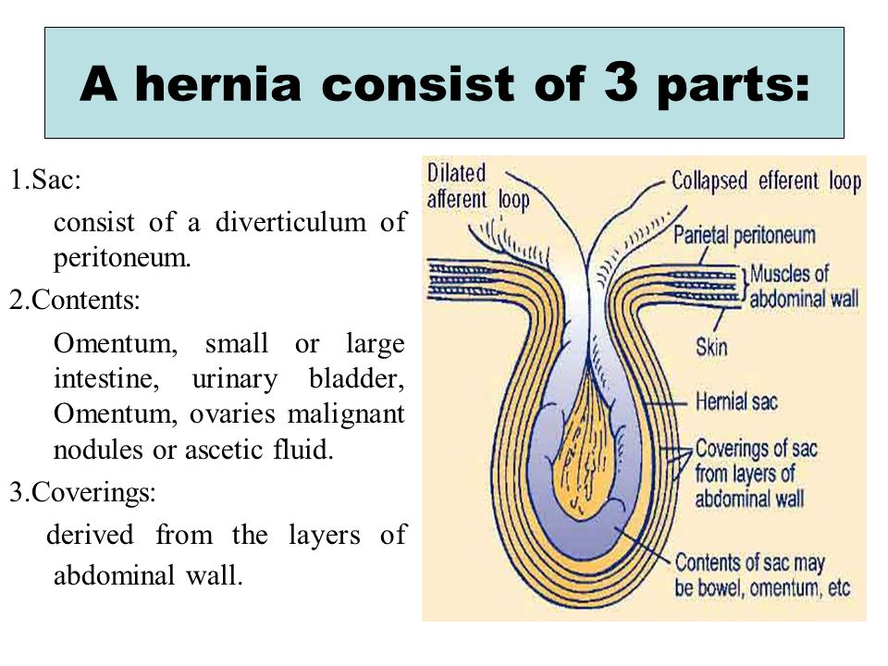

Slide 271
Accounts for 20% of SBO
Commonest Types:
1. Femoral hernia
2. direct / indirect inguinal
3. Umbilical
4. Hiatal
5. Others: incisional (ventral)
Site of obstruction is the neck of hernia
The compromised viscus(plural for viscera) is within the sac.
Notes:
-volvulus: Intestinal volvulus is defined as a complete twisting of a loop of intestine around its mesenteric attachment site.
-incarceration: passage of a loop of intestine through a small orifice, e.g. inguinal canal, with resulting swelling, obstruction and occlusion of blood supply
-Obstruction:partial or complete blockage of the bowel that prevents the contents of the intestine from passing through
-intussusception: process in which there is telescoping of a proximal segment of intestine invaginates into the (distal) adjoining intestinal lumen

Slide 272
Terms in hernia
Reducible: A hernia that can be gently pushed back into place or that disappears when the person lies down.
Irreducible: Emergency
Incarcerated: That has mild symptoms does not exaggerate on coughing; reducible but has fecal content.
Strangulated:The intestine is blocked and the blood supply cut off. Emergency

Slide 273
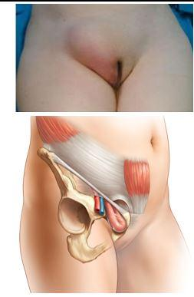
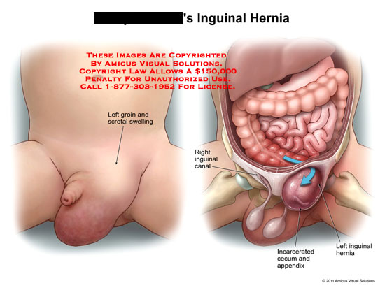
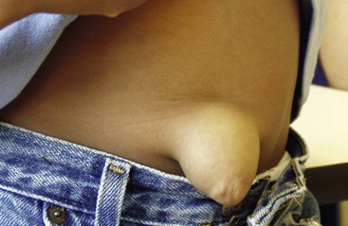
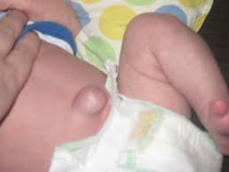
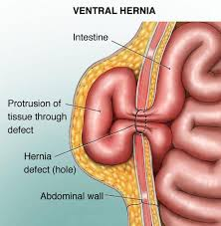

Slide 274



Management
Conservative: pressure
Herniorrhaphy
Surgery: Herniotomy
Herniorraphy
Hernioplasty

Slide 275
Obstruction by a Volvulus
A twisting or axial rotation of a portion of bowel about its mesentery. When complete it forms a closed loop obstruction→ ischemia
SURGICAL EMERGENCY!!!!!!!!

Slide 276



Slide 277
Can be primary or secondary:
1°: congenital malformation of the gut
(e.g: volvulus neonatorum, cecal or sigmoid volvulus)
2°: more common, due to rotation of a piece of bowel around an acquired adhesion or stoma
Commonest spontaneous type in adult is sigmoid, can be relieved by decompression per anal
Surgery is required to prevent or relieve ischemia

Slide 278
Surgical Management
Laparascopy
Laparatomy
Sigmoidoscopy

Slide 279
Acute intussusceptions SURGICAL EMERGENCY!!!!
Occurs when one portion of the gut becomes invaginated within an immediately adjacent segment.
Common in 1st year of life or after a viral illness→ enlargement of Peyer’s patches(grp of lymph nodes)
Ileocolic is the commonest variety in child.
Colocolic intussusception commonest in adult

Slide 280
An intussusceptions is composed of three parts :
the entering or inner tube;
the returning or middle tube;
the sheath or outer tube (intussusceptions).

Slide 281


Slide 282

Red currant jelly stools

Slide 283

Signs.symptoms: child
Classically, a previously healthy infant presents with colicky pain and vomiting (milk then bile).
Between episodes the child initially appears well.
Later, they may pass a ‘red currant
jelly’ stool.

Slide 284
CARDINAL FEATURES:
Colicky pain
Vomiting
Abd distention
Constipation
OTHER FEATURES:
Dehydration
Hypokalaemia
Pyrexia
Abd tenderness

Slide 285
INVESTIGATIONS:
Lab:
FBC (leukocytosis, anaemia, hematocrit, platelets)
Clotting profile
Arterial blood gasses
U& Crt, Na, K, Amylase, LFT and glucose, LDH
Group and save (x-match if needed)
Optional (ESR, CRP, Hepatitis profile)

Slide 286
Radiological:
Plain ABDOMINAL xrays
USS ( free fluid, masses, mucosal folds, pattern of paristalsis, Doppler of mesenteric vasulature, solid organs)
Other advanced studies (CT, MRI, Contrast studieS)

Slide 287
TREATMENT OF INTESTINAL OBSTRUCTION
Supportive
1. Resuscitation
2. Ryle tube free flow with 4 hourly aspiration
-Decompression of proximal to the obstruction, reduce subsequent aspiration during induction of anesthesia and post extubation.

Slide 288
3. IV drip normal saline / Hartmann
4. Broad spectrum antibiotic (not mandatory but need in all patient undergoing surgery.

Slide 289
Surgical
Ind: obstructed / strangulated external hernia, Internal intestinal strangulation and acute obstruction
Midline incision usually look on CECUM
Operative decompression
Look at viability of intestine
Large bowel obstruction: colostomy
Notes:
Immediate intervention:
Evidence of strangulation (hernia….etc)
Signs of peritonitis resulting from perforation or ischemia
In the next 24-48 hours
Clear indication of no resolution of obstruction ( Clinical, radiological).
Diagnosis is unclear in a virgin abdomen
Viable:
-dark color comes lighter, peristalsis, shiny peritoneum, maesentery bleeds if pricked, firm intestinal musculature, pressure ring may or may not disappear
Non viable:
-dark color remains, no peristalsis, dull and lusterless peritoneum, no bleeding if mesentery is pricked, flabby, thin, and friable intestinal musculature, pressure ring persist.
Resuscitation then opened abdomen through midline incision
Assess caecum : distension means large bowel involvement
Removable lesion found in caecum, ascending colon, or proximal transverse colon→ right hemicolectomy should be performed
Lesions is irremovable, a proximal stoma or ileo transverse bypass should be considered

Slide 290
MANAGEMENT FOR LARGE BOWEL OBSTRUCTION
All patients require
Adequate resuscitation
Prophylactic antibiotics
Consenting and marking for potential stoma formation
At operation
Full laparotomy should be performed
Liver should be palpated for metastases
Colon inspected for synchronous tumors

Slide 291
Complications associated with intestinal obstruction repair
excessive bleeding
infection
formation of abscesses (pockets of pus)
leakage of stool from an anastomosis
adhesion formation
paralytic ileus (temporary paralysis of the intestines)
reoccurrence of the obstruction.

Slide 292
ADYNAMIC OBSTRUCTION

Slide 293
Adynamic can be due to:
neurological causes
Is a result of excessive sympathetic stimulation or lack of parasympathetic stimulation
( paralytic ileus )
vascular obstruction
Atheroma in the blood vessels
Embolism
Ileus 2º to mechanical obstruction

Slide 294
Neurological causes: 1. PARALYTIC ILEUS
A state in which there is a failure of transmission of peristaltic waves 2° to neuromuscular failure ( in Auerbach’s and Meissner’s plexuses)
Stasis → leads to accumulation of fluid and gas within bowel:-distension, vomiting, absence of bowel sound and absolute constipation
Notes:
Postoperative: only 24 to 72 hours. Prolonged in hypoproteinemia, and metabolic abnormality
Infection: intraabdominal sepsis
Metabolic: uremia and hypokalemia
Reflex ileus: spine, rib, retroperitoneal hemorrhage and application of plaster jacket

Slide 295
Varieties factors: postoperative, infection, reflex ileus and metabolic
Radiological: gas filled loops of intestines with multiple fluid levels

Slide 296
Management:
Essence of treatment→ prevention with use of nasogastric suction and restriction of oral intake until bowel sound and passage of flatus return
Maintain electrolyte balance

Slide 297
Specific treatment:
Remove primary cause
Decompressed GI distension
If prolong paralytic ileus , consider laparotomy→ exclude hidden cause and facilitate bowel decompression

Slide 298
2. Hirschsprung’s Disease
Hirschsprung disease is a developmental disorder characterized by absence of ganglia in the distal colon, resulting in a functional obstruction.
Diagnosed early in life and should be considered in any newborn who does not pass stool in the first 24-48 hrs of life
Surgical removal of the aganglionic portion is done

Slide 299
PSEUDO-OBSTRUCTION
Obstruction usually colon- occur in the absence of mechanical cause or acute intra-abdominal disease.
Associated with a variety of syndromes in which there is underlying neuropathy and/or a range of other factors

Slide 300
Small intestinal pseudo-obstruction
may be primary (i.e. idiopathic or associated with
familial visceral myopathy or secondary.
There’s recurrent subacute obstruction.
The diagnosis is made by the exclusion of a mechanical cause.

Slide 301
Treatment consists of
initial correction of any underlying disorder.
Metoclopramide and erythromycin may be of use

Slide 302
Colonic pseudo-obstruction (Ogilvie’s syndrome )
Can be acute / chronic. Usually acute.
Radiographs :colonic obstruction, with marked cecal distension
Confirmation of absence of mechanical cause by colonoscopy or single contrast water soluble barium enema or CT should be done.
Treated by colonoscopic decompression

Slide 303
Vascular obstruction: Acute Mesenteric Occlusion
Acute ischemic of mesenteric vessel.
Causes: Atrial fibrillation(AF), Mural thrombosis, atheromatous plaque from aortic aneurysm and valve vegetation from endocarditis
Features:Sudden onset of severe abd. pain in pt with AF and atherosclerosis, Persistent vomiting and defecation, melena stools, Hypovolemic shock

Slide 304
Investigations: - Neutrophil leukocytosis
- Abd Xray: Absence of gas in thickened small intestines
Treatment: - Anti-coagulant
- Embolectomy
- Revascularization
- Colectomy

Slide 305
CANCER OF RECTUM AND COLON
Most prevalent intestinal cancer
Occurs both in male and female
Etiology
Associated with:
Diverticulosis
Ulcerative colitis
Low fibre diet
Excessive fat or protein

Slide 306
Pathophysiology
It is thought that the intestinal bacteria produce carcinogens from the dietary fat and from the bile steroids

Slide 307
Clinical manifestation
Rectal bleeding
Alternating constipation and diarrhea
Pain in the lower quadrant
Anemia-hypochromic
A lump in the iliac fossa
Abdominal distention
Weakness and general malaise

Slide 308
Diagnosis
Barium enema
Barium meal
Sigmoidoscopy
Fibre optic colonoscopy

Slide 309
Management
Surgical excision and creation of colostomy
Chemotherapy
Radiation
Pre-op management
Post-management
Care of colostomy

Slide 310
HAEMORRHOIDS
Dilated veins at the anal area
Types
External-small dilated veins situated on the anal margin
Internal-found inside the bowel

Slide 311
Etiology
Prolonged constipation
Prolonged Straining when defecating, coughing, sneezing
Pregnancy
Heavy lifting
Large pelvic tumors
Liver disease
Anal sex

Slide 312


Patients in lithotomy position with hemorrhoids

Slide 313
Clinical manifestations
Bleeding during defecation
Feels a mass in the rectum
Prolonged constipation
Pain of the prolapse

Slide 314
Management
Warm compressions or sitz births
Diet high in fibers
Drugs( laxatives, steroid suppositories hemorrhoids)
Sclerotherapy (quinine, polidocanol or zinc chloride)
Rubber band ligation (banding)
Hemorrhoidectomy-post op care

Slide 315
Post-op Complications
Pain in their anal region afterwards.
Bowel movements and sitting can hurt as a result.
Bleeding
wound infections, abscesses,
narrowing of the anus (anal stenosis)
fecal incontinence.

Slide 316
7. PERITONITIS
Peritonitis is an inflammation of the peritoneum, the serous membrane that lines part of the abdominal cavity.
Localized or generalized, and may result from infection and from a non-infectious process.

Slide 317
Classification/types
1-Infected peritonitis (localized or generalized infected peritonitis) or none infected peritonitis
2 Primary or secondary peritonitis

Slide 318
Primary peritonitis is caused by the spread of an infection from the blood and lymph nodes to the peritoneum.
Secondary peritonitis is the more common type of peritonitis, happens when the infection comes into the peritoneum from the gastrointestinal or biliary tract

Slide 319
Risk factors
1º
Liver disease (cirrhosis)
Ascites
Weak immune system
PID

Slide 320
2⁰
Appendicitis (inflammation of the appendix)
Stomach ulcers, Twisted intestine, Pancreatitis
Inflammatory bowel disease, Injury caused by an operation.
Peritoneal dialysis, Trauma.

Slide 321
Infected peritonitis
pyogenic bacteria - E-coli
Aerobic and anaerobic streptococci staphylococci
Causative organisms

Slide 322
Perforation of the distal colon
perforation of the stomach as peptic ulcer, gastric carcinoma
perforation of the duodenum (peptic ulcer)

Slide 323
perforation of the remaining intestine (e.g., appendicitis, inflammatory bowel disease, intestinal infarction, intestinal strangulation, colorectal carcinoma.

Slide 324
Or perforation of the gall bladder (cholesystitis).
Other possible reasons for perforation include abdominal trauma, ingestion of a sharp foreign body, perforation by an endoscope or catheter.

Slide 325
Disruption of the peritoneum, even in the absence of perforation of a hollow viscus, may also cause infection by letting micro-organism into the peritoneal cavity. Examples include trauma, surgical wound, continuous ambulatory peritoneal dialysis, and intra-peritoneal chemotherapy.

Slide 326
Non-infected peritonitis
Leakage of sterile body fluids into the peritoneum, such as blood, gastric juice (e.g., peptic ulcer, gastric carcinoma), bile (e.g., liver), urine (pelvic trauma), pancreatic juice (pancreatitis).

Slide 327
Pathogens may come from
direct entry through an operative or traumatic wound.
Intra-peritoneal dialysis predisposes to peritoneal infection
Though blood spread in cases of septicemia and pyemia but is rare.
Systemic or localized infections (such as tuberculosis) may rarely have a peritoneal localization.

Slide 328
Clinical features:
Diffuse abdominal rigidity, Swelling and tenderness in the abdomen with pain ranging from dull aches to severe, sharp pain is often present, especially in generalized peritonitis
Fever and chills, loss of appetite, thirst, nausea and vomiting.

Slide 329
Reduced urine output
Not being able to pass gas or stool
Sinus tachycardia
Paralytic ileus with nausea, vomiting, distension

Slide 330
Auscultation reveals absent of bowel sound due to paralytic ileus
In neglected cases the patient will present by sunken eyes

Slide 331
Diagnostic parameters:
A diagnosis of peritonitis is based on the clinical manifestations.
Blood picture for leukocytosis.
hypokalemia, hypernatremia, and acidosis may be present, but they are not specific findings.
Abdominal X-rays may reveal dilated, edematous intestines,

Slide 332
Computed tomography may be useful in differentiating causes of abdominal pain.
Paracentesis.
Culture of the peritoneal fluid

Slide 333
Nursing Care
Control pain=analgesics, positioning, lateral
Monitor and document the severity, consistency, location and other characteristics of pain.
The patient is placed on the side with knees flexed; this position decreases tension on the abdominal organs and maximize comfort.

Slide 334
Accurate recording of all intake and output and central venous pressure assists in calculating fluid replacement.
Monitor the quantity and quality of output from nasogastric tube
Maintain intravenous therapy.
Monitor the patient for signs and symptoms of shock.

Slide 335
Monitor the patient's bowel sounds by assessing for flatus or bowel movement.
Monitor the patient's mental, cardiac, and pulmonary status.

Slide 336
Monitor Signs that indicate that peritonitis is subsiding include a decrease in temperature and pulse rate, softening of the abdomen, return of peristaltic sounds, passing of flatus, and bowel movements.
Increase fluid and food intake gradually and reduces parenteral fluids as prescribed.

Slide 337
Medical /Surgical Treatment of peritonitis:
General supportive measures such as intravenous rehydration and correction of electrolyte disturbances.
Antibiotics are usually administered intravenously, but they may also be infused directly into the peritoneum.
laparotomy is needed to perform a full exploration and lavage of the peritoneum.

Slide 338
Preoperative preparation:
A nasogastric tube is inserted to deflate the stomach and bowels and to prevent vomiting during induction of anesthesia.
Intravenous fluids as saline or ringer solution are administered to correct the hypovolemia.
Antibiotics: a combination of ampicillin, an aminoglycoside and metroniazol can cover all aerobic and anaerobic organisms.

Slide 339
Analgesics are given for pain relieve.
Foley catheter is inserted to check the urine output and the adequacy of fluid replacement.

Slide 340
Post operative care:
Continuous antibiotic treatment.
Drains are inserted during the surgical procedure, and the nurse must observe and record the character of the drainage postoperatively.

Slide 341
Care must be taken when moving and turning the patient to prevent the drains from being dislodged.
Prepare the patient and family for discharge by teaching him to care for the incision and drains if he will be sent home with the drains.

Slide 342
Complications
Sequestration of fluid and electrolytes, as revealed by decreased central venous pressure, may cause electrolytes disturbances.
hypovolemia, leading to shock and acute renal failure.

Slide 343
A peritoneal abscess.
sepsis may develop, so blood cultures should be obtained.
The fluid may push on the diaphragm, causing splinting and subsequent breathing difficulties.
Formation of fibrous tissue in the peritoneum
Adult respiratory distress syndrome.

Slide 344
8. ACUTE APPENDICITIS
Appendicitis = Inflammation of the appendix.
Mostly young people (age 10-20) but can present at any age
M>F (1.4:1)
Common – 7-9% lifetime risk

Slide 345
Appendix lumen may become obstructed by:-
Fecal material-
Foreign body-
Carcinoma of the cecum-
Stenosis-
Inflammation-
Kinking of the organ

Slide 346
Pathophysiology
Appendix fills and empties as the cecum. If obstruction from any of the above factors occurs, the appendix subsequently becomes filled with mucus and swells, increasing pressures within the lumen and the walls of the appendix, resulting in thrombosis and occlusion of the small vessels, and stasis of lymphatic flow.

Slide 347


Fecalith obstructing lumen
inflammation

Slide 348
“Typical” Presentation
Dull, crampy central abd pain
Malaise/vomiting/anorexia/low grade fevers
Pain worsens & localises to RIF with cough/movement tenderness
Systemic symptoms

Slide 349


Early Appendicitis
Pain:
Location: Periumbilical
Character: Dull
Over time: Colicky
Associated symptoms:
Vomiting
Anorexia
obstruction
distension
mucus

Slide 350
Later Appendicitis
Pain:
Location: R. Iliac Fossa
Character: Localised
Over time: Constant
Aggravating: going over bumps, coughing, walking
Relieving: hip flexion, staying still

Slide 351
Exam findings:
“peritonism”
Guarding
rebound tenderness
percussion tenderness
Rovsing, Psoas, other signs

Slide 352
Late Appendicitis
Pain:
Location: lower abdominal/generalised
Character: diffuse, severe
Over time: constant
Aggravating: movement, coughing, palpation, rebound
Associated: Fever

Slide 353
Exam findings:
Systemic features- fever, tachycardia, hypotension
Abdominal – severe, generalised “peritonism”
RIF mass (sometimes)

Slide 354

Special Clinical signs
Abdominal examination
Psoas Sign – pain on hip extension
Rovsing Sign – R. iliac fossa pain on palpating LIF
“The walk” – walk with R hip flexed, bent over
Pain on coughing/unable to cough

Slide 355
Complications
Rupture and sepsis
Periappendiceal Abscess

Slide 356
Clinching the diagnosis
Appendicitis is usually a clinical diagnosis- ie history + examination.
However sometimes you’re just not sure! All those ovaries, fallopian tubes, ureters, atypical presentations…
…perhaps you could order some tests?

Slide 357
Pathology/Lab investigations
White cell count (WCC) – usually mildly elevated.
C. reactive protein (CRP) – also elevated
Urinalysis sometimes positive for blood, leuks; not very helpful in discriminating vs UTI

Slide 358
Electrolytes, renal function, haemoglobin, platelets, liver function, coagulation should all be normal unless profoundly unwell- if abnormal think of other things.

Slide 359
Imaging
CT
Good for getting an overview of all the structures esp bowel
Accurate- sensitive and specific >90%
Less good at pelvic anatomy than abdominal anatomy
Radiation exposure
Ultrasound(will rule out other conditions)

Slide 360
Diagnostic Laparoscopy
Safe
Useful for when diagnosis is unclear
Esp in females w/ suspected gynecological pathology e,g endometriosis/menstruating/ovulating)

Slide 361
Management
Supportive / symptomatic management
Antibiotics/fluids/etc
Treatment of underlying cause
3. Appendectomy

Slide 362
Septic shock
Systemic inflammatory response- usual appropriate local responses make no sense when :-
Generalised vasodilation (flushing), capillary leak- fluid leaves central circulation
Hypotension, tachycardia- organs not perfused properly

Slide 363
Either fever or hypothermia
Other complications like coagulopathy/DIC/multiorgan failure present
ARDS in severe sepsis- hypoxia ocuurs

Slide 364
Treatment of infection, sepsis
Antibiotics- in appendicitis cover gram negs (gentamicin/ceftriaxone), enterococcus (ampicillin/vancomycin), anaerobes (metronidazole)
Drain pus, remove infected material

Slide 365
Replace fluid that is lost peripherally – IV cannula, fluid resuscitation
Blood tests, imaging, other tests- find source
Correct other organ dysfunction
If necessary ICU and advanced life support

Slide 366


Appendectomy - Laparoscopic
“Keyhole” surgery
Lower complication rate, quicker recovery
Sometimes difficulty in mobilisation requiring open procedure

Slide 367

Appendicectomy - Open
Incision over McBurney’s point or point of maximal tenderness
Straightforward, good exposure, technically easier
Longer recovery, risk of hernia &
adhesions, can’t see pelvic structures as well

Slide 368
COLOSTOMY

Slide 369
An artificial opening for elimination of faecal matter
Indication
-Cancer
-Perforated diverticular
-Enteric fistula
-Intestinal obstruction
-Penetrating injuries

Slide 370
Types
-Ascending
-transverse ( loop and double barrel)
-Descending/ sigmoid
Pre op care
-Psychological care and counseling
-Involve the relatives in the care
-Health messages
-allay anxiety

Slide 371


Slide 372

Both ends of the bowel are brought through the abdomen to the skin surface as two separate sections.
Distal colon is not removed but bypassed.
The proximal stoma, diverts feces to the abdominal wall.
Distal stoma lets out mucus

Slide 373



Slide 374
Skin preparation
Apply adhesives to ascertain allergies
Correct any fluid electrolyte imbalance
Post op care
Observe stoma for color
Observe for drainage and rule out obstruction
Change colostomy bag appropriately
Dress the stoma as directed

Slide 375
Colostomy irrigation
-Patients education
Complications
-Infections
-Bowel prolapse
-Perforation
-Blockage

Slide 376
Patient to seek medical care if:-
Severe cramps lasting more than two or three hours
Unusual odor lasting more than a week
Unusual change in stoma size and appearance
Obstruction at the stoma and/or prolapse of the stoma
Excessive bleeding from the stoma opening, or a moderate amount in the pouch

Slide 377
Severe injury or cut to the stoma
Continuous bleeding at the junction between stoma and skin
Watery discharge lasting more than five or six hours
Chronic skin irritation
Stenosis of the stoma (narrowing)
Unable to wear the pouching system for 2-3 days without leakage

Slide 378
END

